Slide 1

Lecture 19 Recovery System
(Chapter 19)
Prof. Jihong Guan
Email: jhguan@tongji.edu.cn
Department of Computer Science and Technology
Tongji University

Slide 2
Outline of the Course
Part 0: Overview
Ch1: Introduction
Part 1 Relational Databases
Ch2: Relational model (data model, relational algebra)
Ch3&4: SQL(Structured Query Language)
Ch5: Advanced SQL
Part 2 Database Design
Ch6: Database design based on E-R model
Ch7: Relational database design
Part 3 Application Design & Development
Ch8: Complex data types
Ch9: Application development
Part 4 Big data analytics
Ch10: Big data
Ch11: Data analytics
Part 5 Data Storage & Indexing
Ch12: Physical storage system
Ch13: Data storage structure
Ch14: Indexing
Part 6 Query Processing & Optimization
Ch15: Query processing
Ch16: Query optimization
☞ Part 7 Transaction Management
Ch17: Transactions
Ch18: Concurrency control
Ch19: Recovery system
Part 8 Parallel & Distributed Database
Ch20: Database system architecture
Ch21-23: Parallel & distributed storage, query processing & transaction processing
Part 9
DB Platform:OceanBase, MongoDB, Neo4J

Slide 3
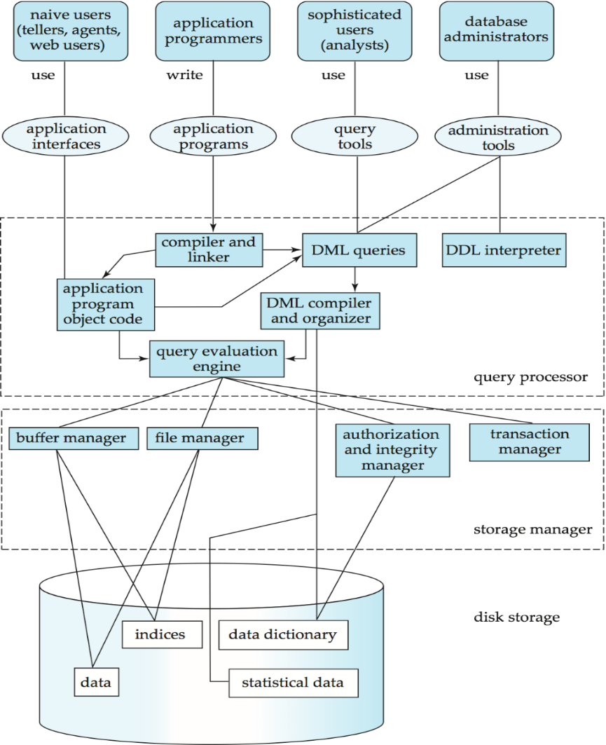
Users
Applications/tools
Database
System
Structure
DBMS
Database

Slide 4
Outline
☞ Failure Classification
Storage
Recovery and Atomicity
Recovery Algorithms
Buffer Management

Slide 5
Failure Classification
Transaction failure (事务故障）
Logical errors, e.g., illegal inputs
System errors, e.g., dead locks
System crash (系统崩溃)
A power failure, or other hardware and software failure causes the system to crash
Disk failure (磁盘故障）
A head crash or similar disk failure destroys all or part of disk storage

Slide 6
Recovery Algorithms
Techniques to ensure database consistency and transaction atomicity despite failures
Recovery algorithms have two parts
Actions taken during normal transaction processing
保证有足够的信息用于故障恢复
Actions taken after a failure
恢复数据库到某个一致性状态

Slide 7
Outline
Failure Classification
☞ Storage
Recovery and Atomicity
Recovery Algorithms
Buffer Management

Slide 8
Storage Structure
Volatile storage (易失性存储器)
does not survive system crashes
e.g., main memory, cache memory
Nonvolatile storage (非易失性存储器）
survives system crashes
e.g., disk, tape, flash memory
Stable storage (稳定存储器)
a mythical form of storage that survives all failures
approximated by maintaining multiple copies on distinct nonvolatile media

Slide 9
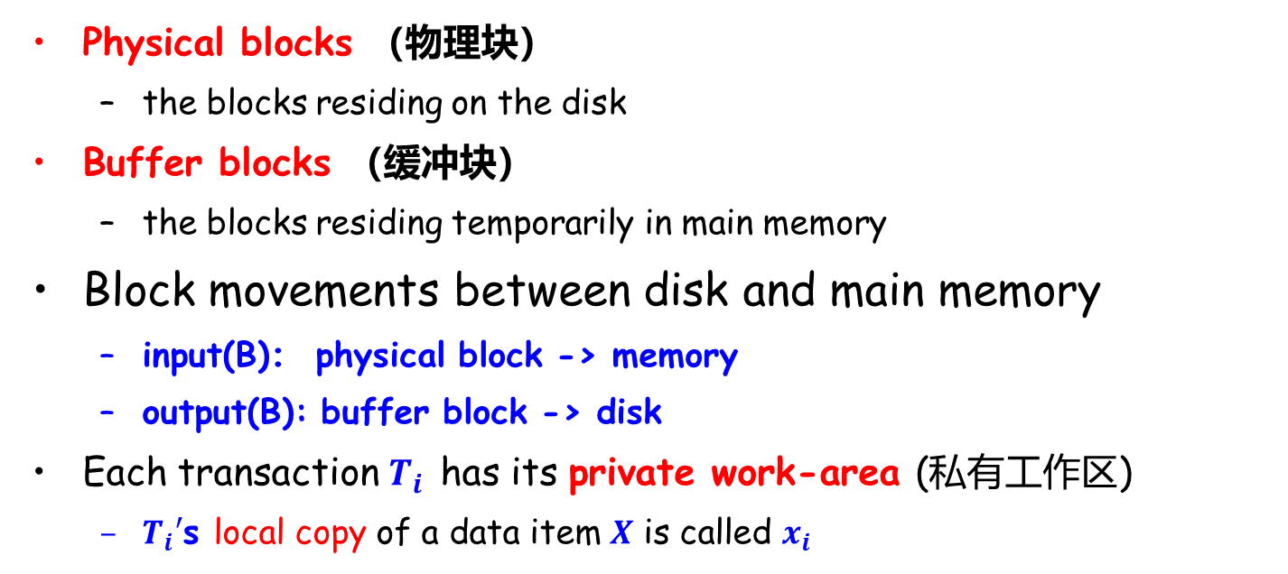
Data Access
Physical blocks （物理块）
the blocks residing on the disk
Buffer blocks （缓冲块）
the blocks residing temporarily in main memory
Block movements between disk and main memory
input(B)： physical block -> memory
output(B): buffer block -> disk
Each transaction $T_{i}$ has its private work-area (私有工作区)
$T_{i}′$s local copy of a data item $X$ is called $x_{i}$

Slide 10
Data Access (Cont.)
Transaction transfers data items between system buffer blocks and its private work-area using
read(X)
write(X)
Transactions
Perform read(X) while accessing X for the first time
All subsequent accesses are to the local copy
After last access, transaction executes write(X)
output(B_{X}) does not need to immediately follow write(X)
System can perform the output operation when it deems fit

Slide 11
Example of Data Access
buffer
Buffer Block A
input(A)
x
Buffer Block B
Y
A
output(B)
B
read(X)
write(Y)
disk
x₂
x₁
y₁
work area
of T₁
work area
of T₂
memory

Slide 12
Outline
Failure Classification
Storage
☞ Recovery and Atomicity
Recovery Algorithms
Buffer Management

Slide 13
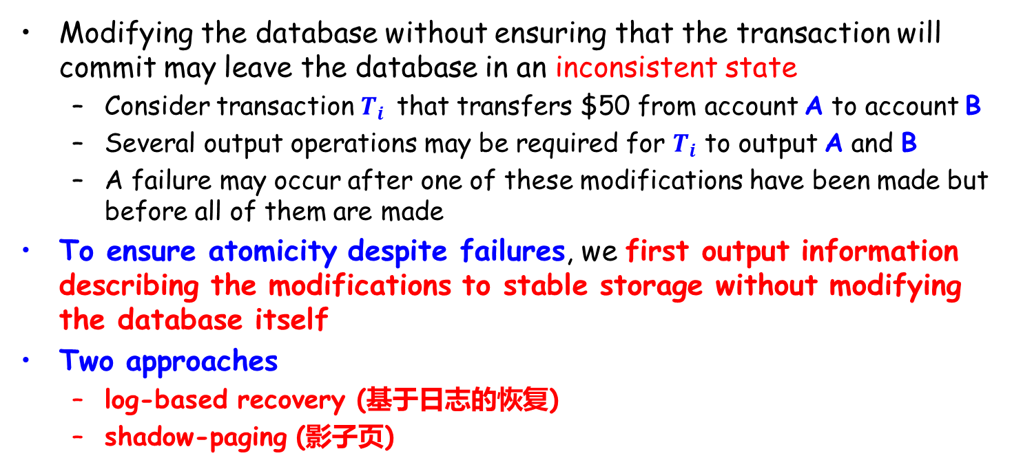
Recovery and Atomicity
Modifying the database without ensuring that the transaction will commit may leave the database in an inconsistent state
Consider transaction $T_{i}$ that transfers $50 from account A to account B
Several output operations may be required for $T_{i}$ to output A and B
A failure may occur after one of these modifications have been made but before all of them are made
To ensure atomicity despite failures, we first output information describing the modifications to stable storage without modifying the database itself
Two approaches
log-based recovery (基于日志的恢复)
shadow-paging (影子页)

Slide 14
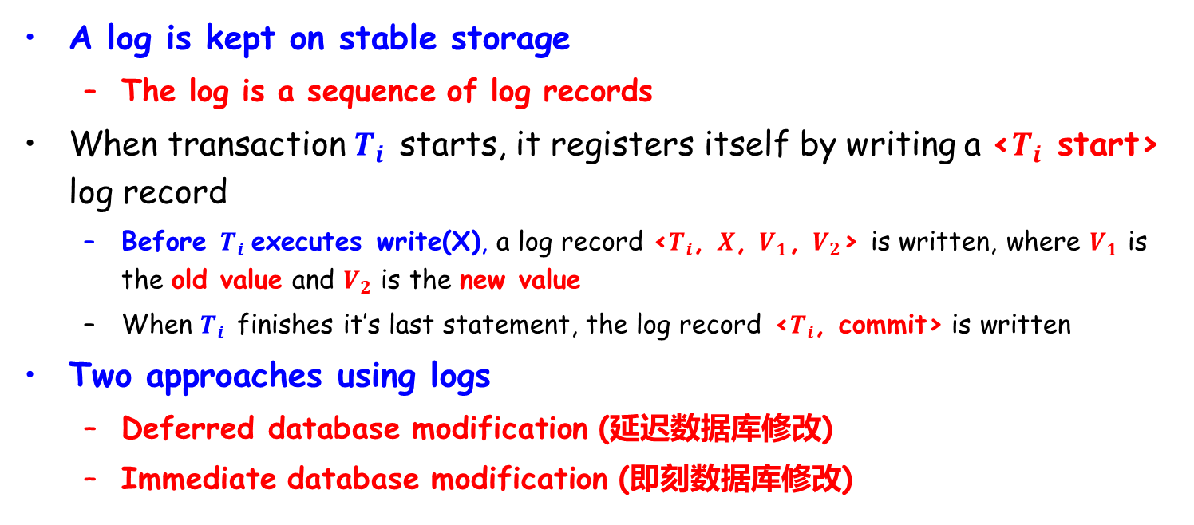
Log-based Recovery
A log is kept on stable storage
The log is a sequence of log records
When transaction $T_{i}$ starts, it registers itself by writing a <$T_{i}$ start> log record
Before $T_{i}$executes write(X), a log record <$T_{i}$, $X$, $V_{1}$, $V_{2}$> is written, where $V_{1}$ is the old value and $V_{2}$ is the new value
When $T_{i}$ finishes it’s last statement, the log record <$T_{i}$, commit> is written
Two approaches using logs
Deferred database modification (延迟数据库修改)
Immediate database modification (即刻数据库修改)

Slide 15
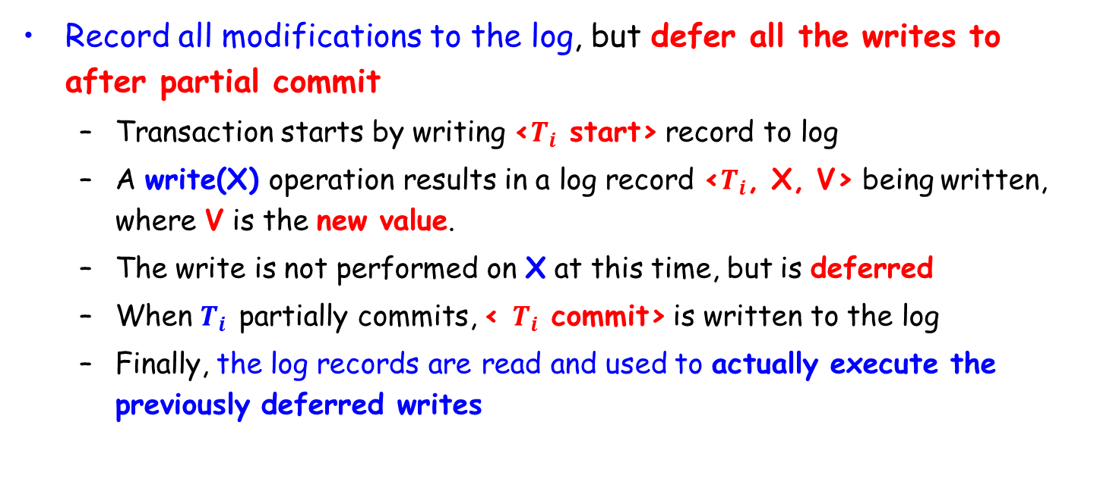
Deferred Database Modification
Record all modifications to the log, but defer all the writes to after partial commit
Transaction starts by writing <$T_{i}$ start> record to log
A write(X) operation results in a log record <$T_{i}$, X, V> being written, where V is the new value.
The write is not performed on X at this time, but is deferred
When $T_{i}$ partially commits, < $T_{i}$ commit> is written to the log
Finally, the log records are read and used to actually execute the previously deferred writes

Slide 16
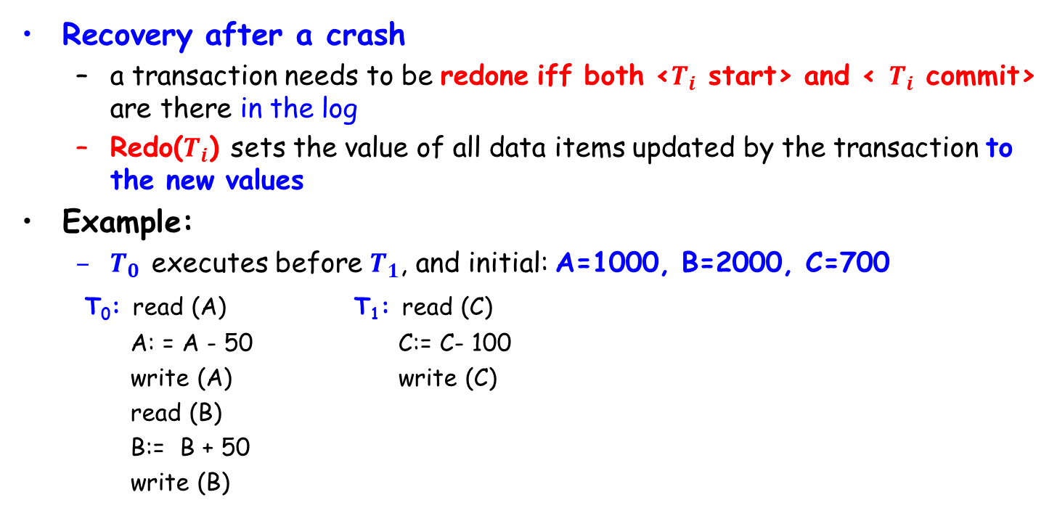
Deferred Database Modification (Cont.)
Recovery after a crash
a transaction needs to be redone iff both <$T_{i}$ start> and < $T_{i}$ commit> are there in the log
Redo($T_{i}$) sets the value of all data items updated by the transaction to the new values
Example:
$T_{0}$ executes before $T_{1}$, and initial: A=1000, B=2000, C=700
T₀: read (A) T₁: read (C)
A: = A - 50 C:= C- 100
write (A) write (C)
read (B)
B:= B + 50
write (B)

Slide 17
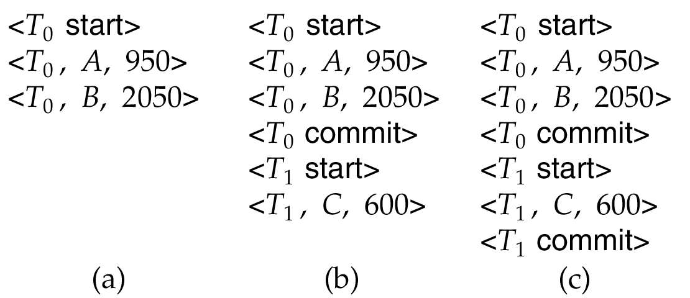
Deferred Database Modification (Cont.)
Recovery actions in each case above are:
(a) No redo actions need to be taken
(b) redo(T₀) must be performed
(c) redo(T₀) must be performed followed by redo(T₁)

Slide 18
Immediate Database Modification
Allows database updates of an uncommitted transaction
Update log records must be written before database items are written
The output of updated blocks can take place at any time before or after transaction commit
Order in which blocks are output can be different from the order in which they are written

Slide 19

Immediate Database Modification Example
Log Write Output
<T₀ start>
<T₀, A, 1000, 950>
<T₀, B, 2000, 2050>
A = 950
B = 2050
<T₀ commit>
<T₁ start>
<T₁, C, 700, 600>
C = 600
B_{B}, B_{C}
<T₁ commit>
B_{A}
Note: B_{X} denotes block containing X
<$T_{i}$, $X$, $V_{1}$, $V_{2}$>,
where $V_{1}$ is the old value,
and $V_{2}$ is the new value

Slide 20
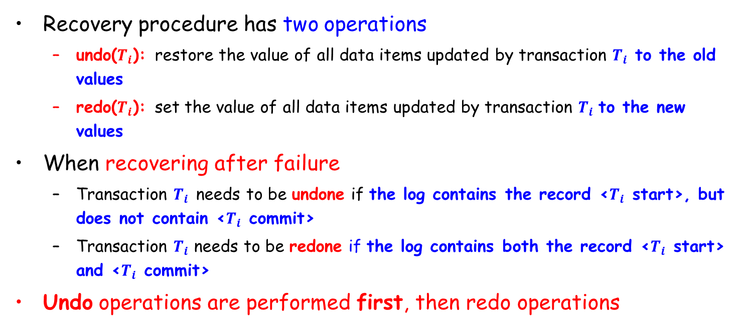
Immediate Database Modification (Cont.)
Recovery procedure has two operations
undo($T_{i}$): restore the value of all data items updated by transaction $T_{i}$ to the old values
redo($T_{i}$): set the value of all data items updated by transaction $T_{i}$ to the new values
When recovering after failure
Transaction $T_{i}$ needs to be undone if the log contains the record <$T_{i}$ start>, but does not contain <$T_{i}$ commit>
Transaction $T_{i}$ needs to be redone if the log contains both the record <$T_{i}$ start> and <$T_{i}$ commit>
Undo operations are performed first, then redo operations

Slide 21
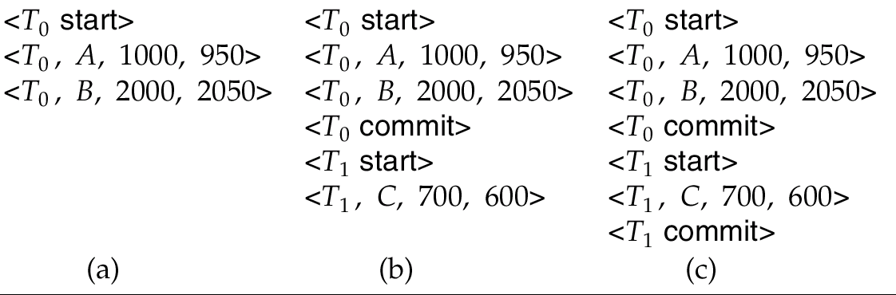
Immediate DB Modification Recovery Example
Recovery actions in each case above are:
(a) undo(T₀)
(b) undo(T₁) and redo(T₀)
(c) redo(T₀) and redo(T₁)

Slide 22
Checkpoints (检查点)
Problems in the recovery procedure
searching the entire log is time-consuming
might unnecessarily redo transactions which have already output their updates to the database
Recovery procedure by setting checkpoints periodically
Output all log records currently residing in main memory to stable storage
Output all modified buffer blocks to the disk
Write a log record <checkpoint> to stable storage

Slide 23
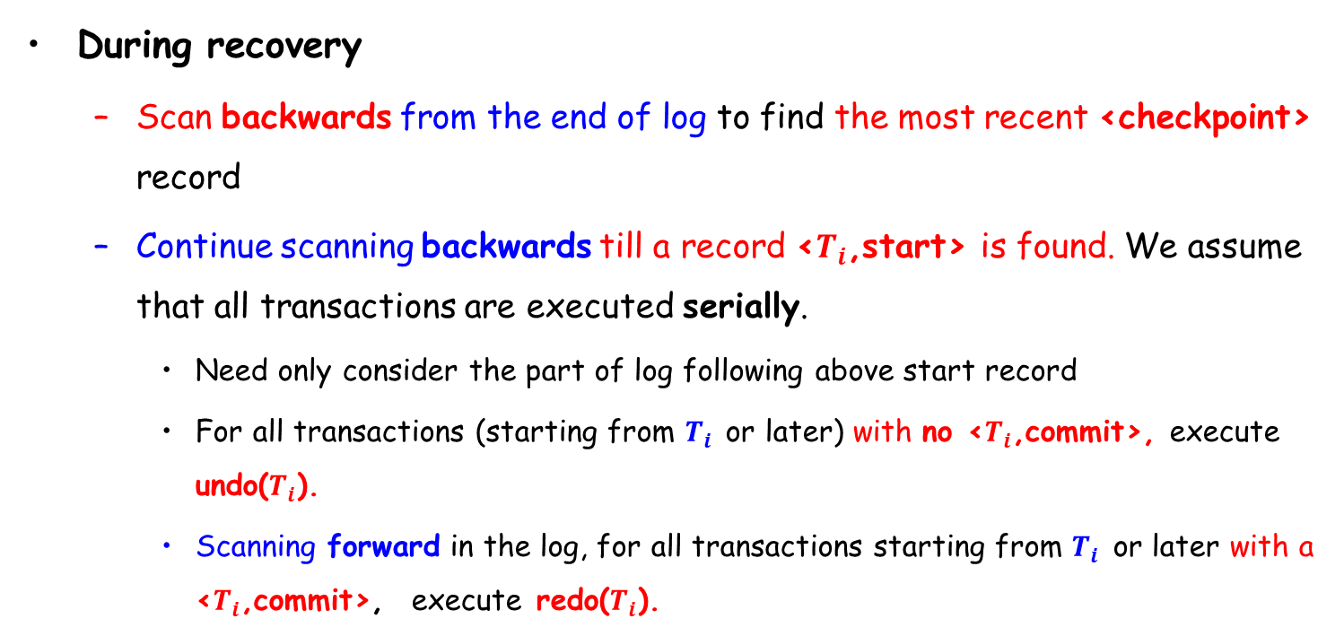
Checkpoints (Cont.)
During recovery
Scan backwards from the end of log to find the most recent <checkpoint> record
Continue scanning backwards till a record <$T_{i}$,start> is found. We assume that all transactions are executed serially.
Need only consider the part of log following above start record
For all transactions (starting from $T_{i}$ or later) with no <$T_{i}$,commit>, execute undo($T_{i}$).
Scanning forward in the log, for all transactions starting from $T_{i}$ or later with a <$T_{i}$,commit>, execute redo($T_{i}$).

Slide 24
Example of Checkpoints
T_{c}
T_{f}
T₁
T₂
T₃
T₄
checkpoint
system failure
T₁ can be ignored (updates already output to disk according to the checkpoint)
T₂ and T₃ redone
T₄ undone

Slide 25
Outline
Failure Classification
Storage
Recovery and Atomicity
☞ Recovery Algorithms
Buffer Management

Slide 26
Recovery with Concurrent Transactions
We modify the log-based recovery schemes to allow multiple transactions to execute concurrently
All transactions share a single disk buffer and a single log
A buffer block can have data items updated by one or more transactions
We assume concurrency control using strict two-phase locking
Logging is done as described earlier
Log records of different transactions may be interspersed（散布）in the log
The checkpointing technique and actions taken on recovery have to be changed

Slide 27
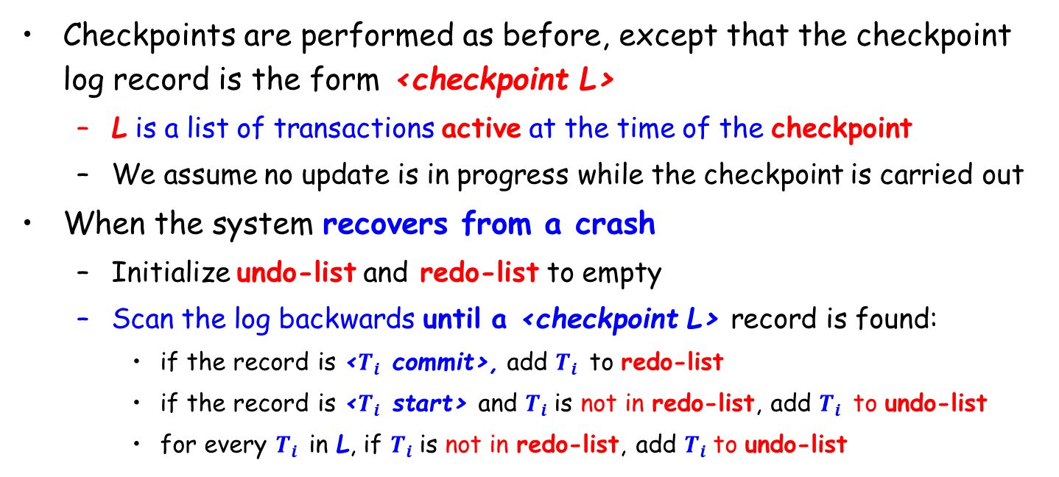
Recovery With Concurrent Transactions (Cont.)
Checkpoints are performed as before, except that the checkpoint log record is the form <checkpoint L>
L is a list of transactions active at the time of the checkpoint
We assume no update is in progress while the checkpoint is carried out
When the system recovers from a crash
Initialize undo-list and redo-list to empty
Scan the log backwards until a <checkpoint L> record is found:
if the record is <$T_{i}$ commit>, add $T_{i}$ to redo-list
if the record is <$T_{i}$ start> and $T_{i}$is not in redo-list, add $T_{i}$ to undo-list
for every $T_{i}$ in L, if $T_{i}$is not in redo-list, add $T_{i}$to undo-list

Slide 28
Example of Recovery
Go through the steps of the recovery algorithm on the following log
<T₀ start>
<T₀, A, 0, 10>
<T₀ commit>
<T₁ start>
<T₁, B, 0, 10>
<T₂ start>
<T₂, C, 0, 10>
<T₂, C, 10, 20>
<checkpoint {T₁, T₂}>
<T₃ start>
<T₃, A, 10, 20>
<T₃, D, 0, 10>
<T₃ commit>
T_{c}
T_{f}
T₀
T₁(Active)
T₂ (Active)
T₃
checkpoint
system failure
Scan log backwards: Undo T1, T2 in undo-list
Scan log forwards: Redo T3 in redo-list

Slide 29
Recovery With Concurrent Transactions (Cont.)
Recovery works as follows
Scan log backwards from the end of the log
During the scan, perform undo for each log record that belongs to a transaction in undo-list
Locate the most recent <checkpoint L> record
Scan log forwards from the <checkpoint L> record till the end of the log
During the scan, perform redo for each log record that belongs to a transaction on redo-list

Slide 30
Outline
Failure Classification
Storage
Recovery and Atomicity
Recovery Algorithms
☞ Buffer Management

Slide 31
Log Record Buffering
Log record buffering
log records are buffered in main memory, instead of being output directly to stable storage
Log records are output to stable storage when a block of log records in the buffer is full, or a log force operation is executed
Log force is performed to commit a transaction by forcing all its log records (including the commit record) to stable storage
Several log records can be output using a single output operation, thus reducing the I/O cost

Slide 32
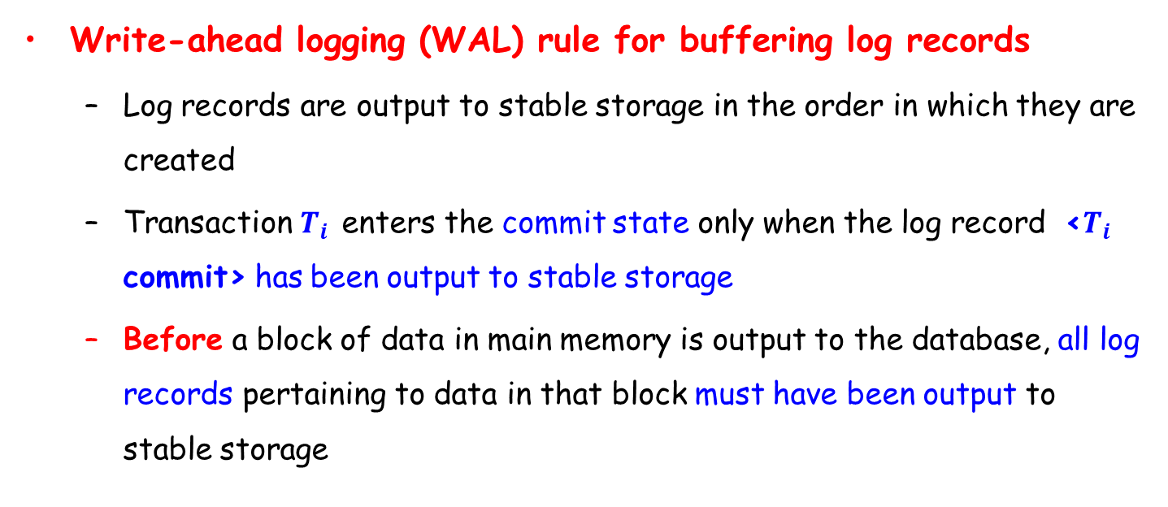
Log Record Buffering (Cont.)
Write-ahead logging (WAL) rule for buffering log records
Log records are output to stable storage in the order in which they are created
Transaction $T_{i}$ enters the commit state only when the log record <$T_{i}$ commit> has been output to stable storage
Before a block of data in main memory is output to the database, all log records pertaining to data in that block must have been output to stable storage

Slide 33
Database Buffering
Database maintains an in-memory buffer of data blocks
When a new block is needed, an existing block should be removed from buffer if the buffer is full
If the block chosen for removal has been updated, it must be output to disk
No update should be in progress on a block when it is output to disk, which is ensured as follows.
Before writing a data item, transaction acquires exclusive lock on block containing the data item
Lock can be released once the write is completed.
Such locks held for short duration are called latches闩锁
Before a block is output to disk, the system acquires an exclusive latch on the block
Ensures no update can be in progress on the block

Slide 34
Buffer Management (Cont.)
Database buffer can be implemented either
in an area of real main-memory reserved for the database, or
in virtual memory
Implementing buffer in reserved main-memory has drawbacks
Memory is partitioned before-hand between database buffer and applications, limiting flexibility
Needs may change, and although operating system knows best how memory should be divided up at any time, it cannot change the partitioning of memory

Slide 35
Buffer Management (Cont.)
Database buffers are generally implemented in virtual memory in spite of some drawbacks
When OS needs to evict（逐出）a page that has been modified, the page is written to swap space on disk
When DB decides to write buffer page to disk, buffer page may be in swap space, and may have to be read from swap space on disk and output to the database on disk, resulting in extra I/O
Known as dual paging（双分页）problem
Ideally when swapping out a database buffer page, operating system should pass control to database, which in turn outputs page to database instead of to swap space (making sure to output log records first)
Dual paging can thus be avoided, but common operating systems do not support such functionality.

Slide 36
Failure with Loss of Nonvolatile Storage
Technique similar to checkpointing used to deal with loss of non-volatile storage
Periodically dump the entire content of the database to stable storage
No transaction may be active during the dump procedure; a procedure similar to checkpointing must take place
Output all log records currently residing in main memory onto stable storage
Output all buffer blocks onto the disk
Copy the contents of the database to stable storage
Output a record <dump> to log on stable storage
To recover from disk failure
Restore database from most recent dump.
Consult the log and redo all transactions that committed after the dump
Can be extended to allow transactions to be active during dump, known as fuzzy dump or online dump

Slide 37
End of Lecture 19

